Slide 1

Unit-1 Introduction to OR & Linear Programming
Operation Research
(OR)
#2301CS729
Prof. Bhavin J Vegada
Department of Mechanical Engineering
bhavin.vegada@darshan.ac.in
9825366601

Slide 2
Course Outline
Introduction to Operation Research
Phases of Operation Research
Applications of Operation Research
Limitations of Operation Research
Introduction to Linear Programming Problem
Formulation of Linear Programming Problem
Simplex Method
Artificial Variables Technique
Big M Method
Two Phase Method
Primal & Dual Conversion

Slide 3
Introduction to Operation Research
Section – 1.1

Slide 4

Introduction to Operation Research
In our daily life we make the decisions even without noticing them. The decisions are taken simply by common sense, judgment and expertise without using any mathematical or any other model in simple situations.
The main activity of a manager is the decision making.
Operations Research tools are not from any one discipline. It takes tools from different discipline such as Mathematics, Statistics, Economics, Psychology, Engineering etc, and combines these tools to make a new set of knowledge for Decision Making.

Slide 5
Definition of Operation Research
The contents and the boundaries of the OR are not yet fixed. Therefore, to give a formal definition of the term Operation Research is a difficult task.
OR is an experimental and applied science developed to observing, understanding and predicting the behavior of purposeful man-machine systems and OR workers are actively engaged in applying this knowledge to practical problems in business, government, and society.
- OR Society of America
OR is a scientific method of providing executive departments with a quantitative basis for decision regarding the operations under their control.
- Morse and Kimbal (1946)
OR may be described as a scientific approach to decision making that involves the operations of an organizational system.
- Hiller and Lieberman
OR is the art of winning wars without actually fighting.
- Aurther Clarke
OR is a scientific approach to problem-solving for executive management.
- H.M. Wagner

Slide 6


Phases of Operation Research
Define the
Problem
Develop the
Mathematical Model
Real-Life
Problem
Modify the
Model
Apply OR Technique to Solve the Model
If Not Optimum
Test the Model for the
Optimum Solution
If Optimum
Exit &
Implement

Slide 7
Phases of Operation Research
Definition of the problem – Identify objective and constraints
Construction of the model – Develop mathematical model
Solution of the model – Apply OR techniques
Validation of the model – Check model with real data
Implementation of the solution – Apply the solution in real-world

Slide 8
Applications of Operation Research
Operation Research has a wide range of applications across various industries and sectors.
Transportation and Logistics
Manufacturing
Healthcare
Finance and Economics
Telecommunications
Energy
Military and Defense
Retail & Marketing
Public Sector
Sports & Entertainment
Agriculture
Project Management

Slide 9
Applications of Operation Research
Operation Research has a wide range of applications across various industries and sectors.
Transportation and Logistics:
Vehicle routing and scheduling
Supply chain optimization
Inventory management
Warehouse location and layout planning
Manufacturing:
Production scheduling
Quality control
Inventory management
Process optimization
Facility layout design

Slide 10
Applications of Operation Research
Healthcare:
Hospital resource management
Staff scheduling
Patient flow optimization
Treatment planning
Supply chain management for medical supplies
Finance and Economics:
Portfolio optimization
Risk management
Pricing strategies
Financial planning
Economic modeling and forecasting

Slide 11
Applications of Operation Research
Telecommunications:
Network design and optimization
Traffic management
Resource allocation
Capacity planning
Energy:
Power generation and distribution optimization
Renewable energy integration
Load forecasting
Maintenance scheduling
Resource allocation

Slide 12
Applications of Operation Research
Military and Defense:
Strategic planning
Logistics and supply chain management
Resource allocation
Mission planning
Risk assessment
Retail and Marketing:
Inventory and stock management
Sales forecasting
Customer relationship management
Marketing mix optimization
Pricing strategies

Slide 13
Applications of Operation Research
Public Sector:
Urban planning
Public transportation optimization
Emergency response planning
Resource allocation
Policy analysis
Sports and Entertainment:
Tournament scheduling
Team selection and strategy
Venue management
Fan engagement strategies

Slide 14
Applications of Operation Research
Agriculture:
Crop planning and scheduling
Resource allocation
Supply chain management
Precision farming
Project Management:
Resource allocation
Scheduling
Risk management
Cost estimation

Slide 15
Limitations of Operation Research
Dependence of Quantitative Data
Implementation Challenges
Over-Reliance
Requires accurate, relevant and
dynamic data
Faces organizational resistance
and practical constraints
Neglects practical judgment, or common sense
Theoretical
Practical
Reliance on Models
Complexity of Problems
Human Factors
Simplifies reality,
omits qualitative factors or wrong assumptions
Involve multiple variables,
conflicting objectives,
unpredictable human behavior, etc.
Ignore human elements like
emotions, resistance to change,
ethics, etc.

Slide 16
Introduction to Linear Programming
Section – 1.2

Slide 17
Introduction
Linear programming is perhaps the most widely applied mathematical technique that helps managers in decision-making and planning for the optimal allocation of limited resources.
Linear programming is most widely accepted tool, as most of the situations in practice can be represented or at least approximated as linear programming models.
It deals with the optimization (maximization or minimization) of a function of variables known as objective function, subject to a set of linear equations and/or inequalities known as constraints.
The objective function may be profit, cost, production capacity or any other measure of effectiveness, which is to be obtained in the best possible or optimal manner.
The constraints may be imposed by different resources such as raw material availability, market demand, production process and equipment, storage capacity, etc.

Slide 18
Assumptions in Linear Programming Models
Proportionality
A basic assumption of linear programming is that proportionality exists in the objective function and the constraints. This assumption implies that if a product yields a profit of ₹ 100, the profit earned from the sale of 15 such products will be ₹ (100 x 15) = ₹ 1500. This may not always be true because of quantity discounts.
Additivity
It means that if we use t₁ hours on machine A to make product 1 and t₂ hours to make product 2, the total time required to make products 1 and 2 on machine A is t₁ + t₂ hours. This, however, is true only if the change-over time from product 1 to product 2 is negligible.
Continuity
The decision variables are continuous i.e., they are permitted to take any real values (fractions, decimals, etc.) that satisfy the constraints. However, there are problems wherein variables are restricted to have integer values only. Though such problems, strictly speaking, are not linear programming problems, they are frequently solved by linear programming techniques and the values are then rounded off to nearest integers to satisfy the constraints.

Slide 19
Assumptions in Linear Programming Models
Certainty
The various parameters, namely, the objective function coefficients, R.H.S. coefficients of the constraints and resource values in the constraints are certainly and precisely known and that their values do not change with time. Thus the profit or cost per unit of the product, labour and materials required per unit, availability of labour and materials, market demand of the product produced, etc. are assumed to be known with certainty. The linear programming problem is, therefore, assumed to be deterministic in nature.
Finite Choices
A linear programming model also assumes that a finite (limited) number of choices (alternatives) are available to the decision-maker and that the decision variables are interrelated and non negative. The non-negativity condition shows that linear programming deals with real-life situations as it is not possible to produce/use negative quantities.

Slide 20
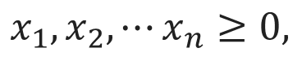
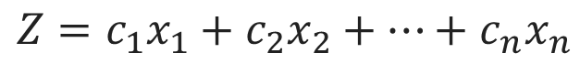

The General Linear Programming Problem
The general linear programming problem can be expressed as follows.
Find the values of variables x₁, x₂, ..., x_{n} which maximize (or minimize) an objective function which is a linear function of variables, such as
$$Z=c_{1}x_{1}+c_{2}x_{2}+⋯+c_{n}x_{n}$$
Subject to the constraints
$$a_{11}x_{1}+a_{12}x_{2}+⋯+a_{1n}x_{n}\left(≤, =, ≥\right) b_{1},$$
$$a_{21}x_{1}+a_{22}x_{2}+⋯+a_{2n}x_{n}\left(≤, =, ≥\right) b_{2},$$
$$⋮$$
$$a_{m1}x_{1}+a_{m2}x_{2}+⋯+a_{mn}x_{n}\left(≤, =, ≥\right) b_{m},$$
and meet the non-negativity restrictions
$$x_{1}, x_{2}, ⋯x_{n}≥0,$$
For each constraint one and only one of signs $(≤ , =, ≥)$holds but the sign may vary from one constraint to another.

Slide 21
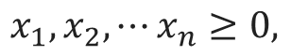
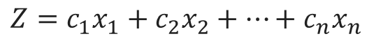

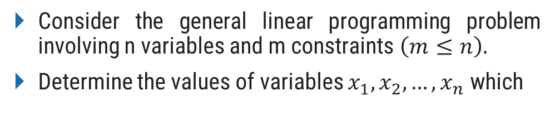

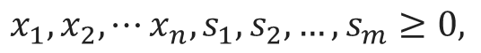
Important Definitions: Solution
Consider the general linear programming problem involving n variables and m constraints $\left(m≤n\right).$
Determine the values of variables $x_{1}, x_{2},…,x_{n}$ which
Introducing slack variables s₁, s₂, ..., s_{m} in the constraints, it can be put in the following standard form
maximize
maximize
$$Z=c_{1}x_{1}+c_{2}x_{2}+⋯+c_{n}x_{n}$$
$$Z=c_{1}x_{1}+c_{2}x_{2}+⋯+c_{n}x_{n}+0s_{1}+…+0s_{m}$$
subject to
$$a_{11}x_{1}+a_{12}x_{2}+⋯+a_{1n}x_{n}\left(≤, =, ≥\right) b_{1},$$
subject to
$$a_{21}x_{1}+a_{22}x_{2}+⋯+a_{2n}x_{n}\left(≤, =, ≥\right) b_{2},$$
$$a_{11}x_{1}+a_{12}x_{2}+⋯+a_{1n}x_{n}+s_{1}=b_{1},$$
$$⋮$$
$$a_{21}x_{1}+a_{22}x_{2}+⋯+a_{2n}x_{n}+s_{2}= b_{2},$$
… (1)
$$a_{m1}x_{1}+a_{m2}x_{2}+⋯+a_{mn}x_{n}\left(≤, =, ≥\right) b_{m},$$
$$⋮$$
where
$$x_{1}, x_{2}, ⋯x_{n}≥0,$$
$$a_{m1}x_{1}+a_{m2}x_{2}+⋯+a_{mn}x_{n}+s_{m}=b_{m},$$
where
$$x_{1}, x_{2}, ⋯x_{n},s_{1}, s_{2},…,s_{m}≥0,$$
… (2)
Solution: A set of variables $\left(x_{1}, x_{2}, ⋯x_{n},s_{1}, s_{2},…,s_{m}\right)$is called a solution to L.P. problem if it satisfies the constraints (1).

Slide 22
Important Definitions: Feasible Solution
Consider the general linear programming problem involving n variables and m constraints $\left(m≤n\right).$
Determine the values of variables $x_{1}, x_{2},…,x_{n}$ which
Introducing slack variables s₁, s₂, ..., s_{m} in the constraints, it can be put in the following standard form
maximize
maximize
$$Z=c_{1}x_{1}+c_{2}x_{2}+⋯+c_{n}x_{n}$$
$$Z=c_{1}x_{1}+c_{2}x_{2}+⋯+c_{n}x_{n}+0s_{1}+…+0s_{m}$$
subject to
$$a_{11}x_{1}+a_{12}x_{2}+⋯+a_{1n}x_{n}\left(≤, =, ≥\right) b_{1},$$
subject to
$$a_{21}x_{1}+a_{22}x_{2}+⋯+a_{2n}x_{n}\left(≤, =, ≥\right) b_{2},$$
$$a_{11}x_{1}+a_{12}x_{2}+⋯+a_{1n}x_{n}+s_{1}=b_{1},$$
$$⋮$$
$$a_{21}x_{1}+a_{22}x_{2}+⋯+a_{2n}x_{n}+s_{2}= b_{2},$$
… (1)
$$a_{m1}x_{1}+a_{m2}x_{2}+⋯+a_{mn}x_{n}\left(≤, =, ≥\right) b_{m},$$
$$⋮$$
where
$$x_{1}, x_{2}, ⋯x_{n}≥0,$$
$$a_{m1}x_{1}+a_{m2}x_{2}+⋯+a_{mn}x_{n}+s_{m}=b_{m},$$
where
$$x_{1}, x_{2}, ⋯x_{n},s_{1}, s_{2},…,s_{m}≥0,$$
… (2)
Feasible solution: A set of variables $x_{1}, x_{2}, ⋯x_{n},s_{1}, s_{2},…,s_{m}$ is called a feasible solution to L.P. problem if it satisfies the constraints (1) as well as non-negativity restrictions (2).

Slide 23
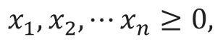
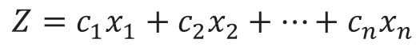
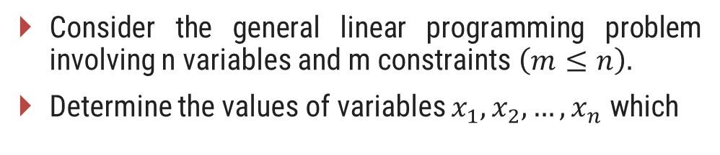
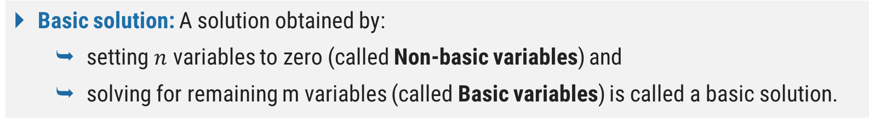
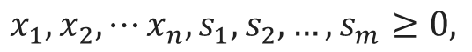
Important Definitions: Basic Solution
Consider the general linear programming problem involving n variables and m constraints $\left(m≤n\right).$
Determine the values of variables $x_{1}, x_{2},…,x_{n}$ which
Introducing slack variables s₁, s₂, ..., s_{m} in the constraints, it can be put in the following standard form
maximize
maximize
$$Z=c_{1}x_{1}+c_{2}x_{2}+⋯+c_{n}x_{n}$$
$$Z=c_{1}x_{1}+c_{2}x_{2}+⋯+c_{n}x_{n}+0s_{1}+…+0s_{m}$$
subject to
$$a_{11}x_{1}+a_{12}x_{2}+⋯+a_{1n}x_{n}\left(≤, =, ≥\right) b_{1},$$
subject to
$$a_{21}x_{1}+a_{22}x_{2}+⋯+a_{2n}x_{n}\left(≤, =, ≥\right) b_{2},$$
$$a_{11}x_{1}+a_{12}x_{2}+⋯+a_{1n}x_{n}+s_{1}=b_{1},$$
$$⋮$$
$$a_{21}x_{1}+a_{22}x_{2}+⋯+a_{2n}x_{n}+s_{2}= b_{2},$$
… (1)
$$a_{m1}x_{1}+a_{m2}x_{2}+⋯+a_{mn}x_{n}\left(≤, =, ≥\right) b_{m},$$
$$⋮$$
where
$$x_{1}, x_{2}, ⋯x_{n}≥0,$$
$$a_{m1}x_{1}+a_{m2}x_{2}+⋯+a_{mn}x_{n}+s_{m}=b_{m},$$
where
$$x_{1}, x_{2}, ⋯x_{n},s_{1}, s_{2},…,s_{m}≥0,$$
… (2)
Basic solution: A solution obtained by:
setting $n$ variables to zero (called Non-basic variables) and
solving for remaining m variables (called Basic variables) is called a basic solution.

Slide 24
Important Definitions: Basic Feasible Solution
Consider the general linear programming problem involving n variables and m constraints $\left(m≤n\right).$
Determine the values of variables $x_{1}, x_{2},…,x_{n}$ which
Introducing slack variables s₁, s₂, ..., s_{m} in the constraints, it can be put in the following standard form
maximize
maximize
$$Z=c_{1}x_{1}+c_{2}x_{2}+⋯+c_{n}x_{n}$$
$$Z=c_{1}x_{1}+c_{2}x_{2}+⋯+c_{n}x_{n}+0s_{1}+…+0s_{m}$$
subject to
$$a_{11}x_{1}+a_{12}x_{2}+⋯+a_{1n}x_{n}\left(≤, =, ≥\right) b_{1},$$
subject to
$$a_{21}x_{1}+a_{22}x_{2}+⋯+a_{2n}x_{n}\left(≤, =, ≥\right) b_{2},$$
$$a_{11}x_{1}+a_{12}x_{2}+⋯+a_{1n}x_{n}+s_{1}=b_{1},$$
$$⋮$$
$$a_{21}x_{1}+a_{22}x_{2}+⋯+a_{2n}x_{n}+s_{2}= b_{2},$$
… (1)
$$a_{m1}x_{1}+a_{m2}x_{2}+⋯+a_{mn}x_{n}\left(≤, =, ≥\right) b_{m},$$
$$⋮$$
where
$$x_{1}, x_{2}, ⋯x_{n}≥0,$$
$$a_{m1}x_{1}+a_{m2}x_{2}+⋯+a_{mn}x_{n}+s_{m}=b_{m},$$
where
$$x_{1}, x_{2}, ⋯x_{n},s_{1}, s_{2},…,s_{m}≥0,$$
… (2)
A Basic feasible solution: It is a basic solution that also satisfies the non-negativity restrictions (2). All variables in a basic feasible solution are $≥ 0$.

Slide 25
Important Definitions: Non-degenerate Basic Feasible Solution
Consider the general linear programming problem involving n variables and m constraints $\left(m≤n\right).$
Determine the values of variables $x_{1}, x_{2},…,x_{n}$ which
Introducing slack variables s₁, s₂, ..., s_{m} in the constraints, it can be put in the following standard form
maximize
maximize
$$Z=c_{1}x_{1}+c_{2}x_{2}+⋯+c_{n}x_{n}$$
$$Z=c_{1}x_{1}+c_{2}x_{2}+⋯+c_{n}x_{n}+0s_{1}+…+0s_{m}$$
subject to
$$a_{11}x_{1}+a_{12}x_{2}+⋯+a_{1n}x_{n}\left(≤, =, ≥\right) b_{1},$$
subject to
$$a_{21}x_{1}+a_{22}x_{2}+⋯+a_{2n}x_{n}\left(≤, =, ≥\right) b_{2},$$
$$a_{11}x_{1}+a_{12}x_{2}+⋯+a_{1n}x_{n}+s_{1}=b_{1},$$
$$⋮$$
$$a_{21}x_{1}+a_{22}x_{2}+⋯+a_{2n}x_{n}+s_{2}= b_{2},$$
… (1)
$$a_{m1}x_{1}+a_{m2}x_{2}+⋯+a_{mn}x_{n}\left(≤, =, ≥\right) b_{m},$$
$$⋮$$
where
$$x_{1}, x_{2}, ⋯x_{n}≥0,$$
$$a_{m1}x_{1}+a_{m2}x_{2}+⋯+a_{mn}x_{n}+s_{m}=b_{m},$$
where
$$x_{1}, x_{2}, ⋯x_{n},s_{1}, s_{2},…,s_{m}≥0,$$
… (2)
Non-degenerate basic feasible solution: It is a basic feasible solution in which all the m basic variables are positive (> 0) and the remaining n variables are zero each.

Slide 26
Important Definitions: Degenerate Basic Feasible Solution
Consider the general linear programming problem involving n variables and m constraints $\left(m≤n\right).$
Determine the values of variables $x_{1}, x_{2},…,x_{n}$ which
Introducing slack variables s₁, s₂, ..., s_{m} in the constraints, it can be put in the following standard form
maximize
maximize
$$Z=c_{1}x_{1}+c_{2}x_{2}+⋯+c_{n}x_{n}$$
$$Z=c_{1}x_{1}+c_{2}x_{2}+⋯+c_{n}x_{n}+0s_{1}+…+0s_{m}$$
subject to
$$a_{11}x_{1}+a_{12}x_{2}+⋯+a_{1n}x_{n}\left(≤, =, ≥\right) b_{1},$$
subject to
$$a_{21}x_{1}+a_{22}x_{2}+⋯+a_{2n}x_{n}\left(≤, =, ≥\right) b_{2},$$
$$a_{11}x_{1}+a_{12}x_{2}+⋯+a_{1n}x_{n}+s_{1}=b_{1},$$
$$⋮$$
$$a_{21}x_{1}+a_{22}x_{2}+⋯+a_{2n}x_{n}+s_{2}= b_{2},$$
… (1)
$$a_{m1}x_{1}+a_{m2}x_{2}+⋯+a_{mn}x_{n}\left(≤, =, ≥\right) b_{m},$$
$$⋮$$
where
$$x_{1}, x_{2}, ⋯x_{n}≥0,$$
$$a_{m1}x_{1}+a_{m2}x_{2}+⋯+a_{mn}x_{n}+s_{m}=b_{m},$$
where
$$x_{1}, x_{2}, ⋯x_{n},s_{1}, s_{2},…,s_{m}≥0,$$
… (2)
Degenerate basic feasible solution: It is a basic feasible solution in which one or more of the m basic variables are equal to zero.

Slide 27
Important Definitions: Optimal Basic Feasible Solution
Consider the general linear programming problem involving n variables and m constraints $\left(m≤n\right).$
Determine the values of variables $x_{1}, x_{2},…,x_{n}$ which
Introducing slack variables s₁, s₂, ..., s_{m} in the constraints, it can be put in the following standard form
maximize
maximize
$$Z=c_{1}x_{1}+c_{2}x_{2}+⋯+c_{n}x_{n}$$
$$Z=c_{1}x_{1}+c_{2}x_{2}+⋯+c_{n}x_{n}+0s_{1}+…+0s_{m}$$
subject to
$$a_{11}x_{1}+a_{12}x_{2}+⋯+a_{1n}x_{n}\left(≤, =, ≥\right) b_{1},$$
subject to
$$a_{21}x_{1}+a_{22}x_{2}+⋯+a_{2n}x_{n}\left(≤, =, ≥\right) b_{2},$$
$$a_{11}x_{1}+a_{12}x_{2}+⋯+a_{1n}x_{n}+s_{1}=b_{1},$$
$$⋮$$
$$a_{21}x_{1}+a_{22}x_{2}+⋯+a_{2n}x_{n}+s_{2}= b_{2},$$
… (1)
$$a_{m1}x_{1}+a_{m2}x_{2}+⋯+a_{mn}x_{n}\left(≤, =, ≥\right) b_{m},$$
$$⋮$$
where
$$x_{1}, x_{2}, ⋯x_{n}≥0,$$
$$a_{m1}x_{1}+a_{m2}x_{2}+⋯+a_{mn}x_{n}+s_{m}=b_{m},$$
where
$$x_{1}, x_{2}, ⋯x_{n},s_{1}, s_{2},…,s_{m}≥0,$$
… (2)
Optimal basic feasible solution: It is the basic feasible solution that also optimizes the objective function.

Slide 28
Important Definitions: Unbounded Solution
Consider the general linear programming problem involving n variables and m constraints $\left(m≤n\right).$
Determine the values of variables $x_{1}, x_{2},…,x_{n}$ which
Introducing slack variables s₁, s₂, ..., s_{m} in the constraints, it can be put in the following standard form
maximize
maximize
$$Z=c_{1}x_{1}+c_{2}x_{2}+⋯+c_{n}x_{n}$$
$$Z=c_{1}x_{1}+c_{2}x_{2}+⋯+c_{n}x_{n}+0s_{1}+…+0s_{m}$$
subject to
$$a_{11}x_{1}+a_{12}x_{2}+⋯+a_{1n}x_{n}\left(≤, =, ≥\right) b_{1},$$
subject to
$$a_{21}x_{1}+a_{22}x_{2}+⋯+a_{2n}x_{n}\left(≤, =, ≥\right) b_{2},$$
$$a_{11}x_{1}+a_{12}x_{2}+⋯+a_{1n}x_{n}+s_{1}=b_{1},$$
$$⋮$$
$$a_{21}x_{1}+a_{22}x_{2}+⋯+a_{2n}x_{n}+s_{2}= b_{2},$$
… (1)
$$a_{m1}x_{1}+a_{m2}x_{2}+⋯+a_{mn}x_{n}\left(≤, =, ≥\right) b_{m},$$
$$⋮$$
where
$$x_{1}, x_{2}, ⋯x_{n}≥0,$$
$$a_{m1}x_{1}+a_{m2}x_{2}+⋯+a_{mn}x_{n}+s_{m}=b_{m},$$
where
$$x_{1}, x_{2}, ⋯x_{n},s_{1}, s_{2},…,s_{m}≥0,$$
… (2)
Unbounded solution: If the value of the objective function can be increased or decreased indefinitely, the solution is called unbounded solution.

Slide 29
Formulation of Linear Programming Problems
Section – 1.3

Slide 30
Formulation of Linear Programming Problem (LPP)
First identify what is the result to be obtained.
Identify the decision variables.
Express the relationship between the variables as a function that needs to be optimized. This function is called the objective function.
Express the constraints in the relationship to the decision variables.
Express the non-negativity constraints.

Slide 31
Requirements For a Linear Programming Problem
Define Objective
Clearly state the goal to maximize or minimize.
Expressed as linear function of decision variables.
Identify Constraints
Express limitations as linear equations or inequalities.
Consider Alternatives
How to approach a linear programming problem?
Explore different methods of allocation.
e.g. same task assigned to different developers.
Ensure Non-Negativity
Confirm decision variables are non-negative. $(≥0)$
Assess Resources
Verify that the resources (Labour, Time, Material) are limited.

Slide 32
Problem 1 (Production Allocation Problem)
A firm produces three products. These products are processed on three different machines. The time required to manufacture one unit of each of the three products and the daily capacity of the three machines are given in the table below.
Machine | Time per unit (minutes) |  |  | Machine capacity (minutes/day)
 | Product 1 | Product 2 | Product 3
M₁ | 2 | 3 | 2 | 440
M₂ | 4 | - | 3 | 470
M₃ | 2 | 5 | - | 430
It is required to determine the daily number of units to be manufactured for each product. The profit per unit for product 1, 2 and 3 is Rs.4, Rs.3 and Rs.6 respectively. It is assumed that all the amounts produced are consumed in the market. Formulate the mathematical (L.P.) model that will maximize the daily profit.

Slide 33
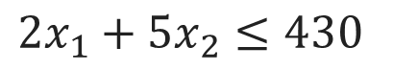
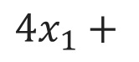
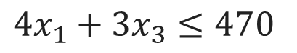
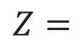
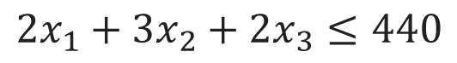
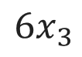
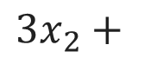

Problem 1 (Production Allocation Problem)
Let the number of units of products, 1, 2 and 3 manufactured daily be x₁, x₂ and x₃ respectively.
Objective Function
Machine | Time per unit (minutes) |  |  | Machine capacity (minutes/day)
 | Product 1 | Product 2 | Product 3
M₁ | 2 | 3 | 2 | 440
M₂ | 4 | - | 3 | 470
M₃ | 2 | 5 | - | 430
Profit per unit | 4 | 3 | 6
Maximize,
$$Z=$$
$$4x_{1}+$$
$$3x_{2}+$$
$$6x_{3}$$
Subject to Constraints
$$2x_{1}+3x_{2}+2x_{3}≤440$$
$$4x_{1}+3x_{3}≤470$$
$$2x_{1}+5x_{2}≤430$$
where $x_{1}, x_{2},x_{3}≥0$

Slide 34
Problem 2 (Diet Problem)
A person wants to decide the constituents of a diet which will fulfil his daily requirements of proteins, fats and carbohydrates at the minimum cost. The choice is to be made from four different types of foods. The yields per unit of these foods are given in the table below:
Food Type | Yield per unit |  |  | Cost per unit (Rs.)
 | Proteins | Fats | Carbohydrates
1 | 3 | 2 | 6 | 45
2 | 4 | 2 | 4 | 40
3 | 8 | 7 | 7 | 85
4 | 6 | 5 | 4 | 65
Minimum Requirement | 800 | 200 | 700
Formulate linear programming model for the problem.

Slide 35
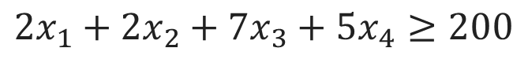
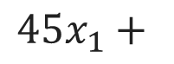
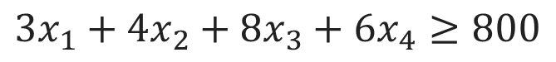
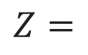
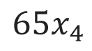
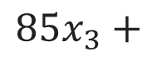
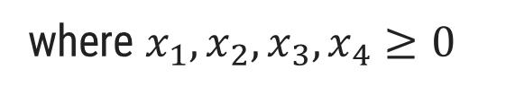
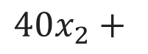
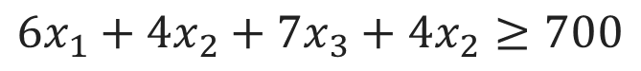
Problem 2 (Diet Problem)
Let x₁, x₂, x₃ and x₄ denote the number of units of food of type 1, 2, 3 and 4 respectively.
Objective Function
Food Type | Yield per unit |  |  | Cost per unit (Rs.)
 | Proteins | Fats | Carbohydrates
1 | 3 | 2 | 6 | 45
2 | 4 | 2 | 4 | 40
3 | 8 | 7 | 7 | 85
4 | 6 | 5 | 4 | 65
Minimum Requirement | 800 | 200 | 700
Minimize
$$Z=$$
$$45x_{1}+$$
$$40x_{2}+$$
$$85x_{3}+$$
$$65x_{4}$$
Subject to Constraints
$$3x_{1}+4x_{2}+8x_{3}+6x_{4}≥800$$
$$2x_{1}+2x_{2}+7x_{3}+5x_{4}≥200$$
$$6x_{1}+4x_{2}+7x_{3}+4x_{2}≥700$$
where $x_{1}, x_{2},x_{3},x_{4}≥0$

Slide 36
Problem 3 (Advertising Media Selection Problem)
An advertising company wishes to plan its advertising strategy in three different media – television, radio and magazines. The purpose of advertising is to reach as large a number of potential customers as possible. Following data have been obtained from market survey:
 | Television | Radio | Magazine I | Magazine II
Cost of an advertising unit | Rs. 30,000 | Rs. 20,000 | Rs.15,000 | Rs.10,000
No. of potential customers reached per unit | 2,00,000 | 6,00,000 | 1,50,000 | 1,00,000
No. of female customers reached per unit | 1,50,000 | 4,00,000 | 70,000 | 50,000
The company wants to spend not more than Rs. 4,50,000 on advertising. Following are the further requirements that must be met:
At least 1 million exposures take place among female customers,
Advertising on magazines be limited to Rs.1,50,000,
At least 3 advertising units be bought on magazine I and 2 units on magazine II,
The number of advertising units on television and radio should each be between 5 and 10.
Formulate linear programming model for the problem.

Slide 37
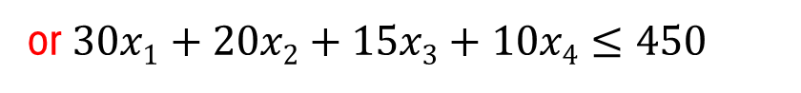

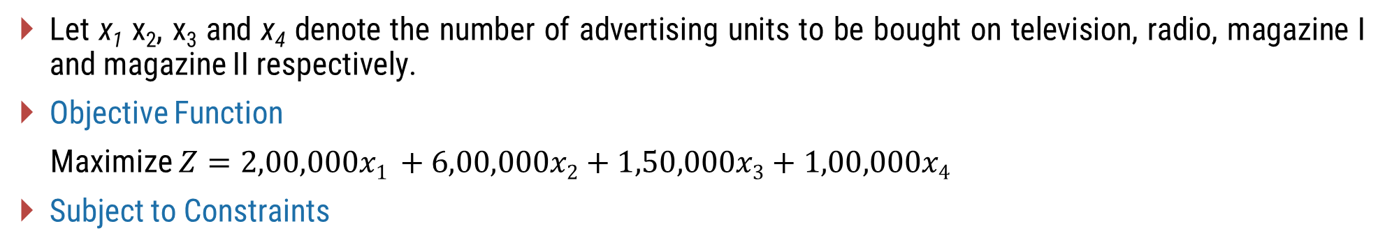
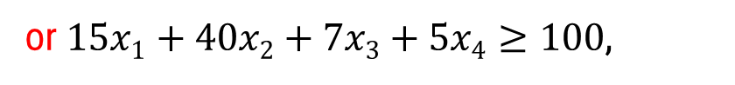
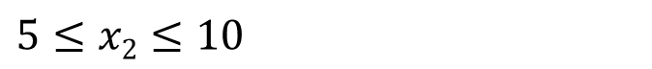
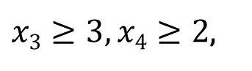
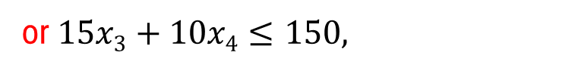
Let x₁ x₂, x₃ and x₄ denote the number of advertising units to be bought on television, radio, magazine I and magazine II respectively.
Objective Function
Maximize $Z=2,00,000x1 +6,00,000x2+1,50,000x3+1,00,000x4$
Subject to Constraints
Advertising budget:
$$30,000x1+20,000x2+15,000x3+10,000x4≤4,50,000$$
or $30x1+20x2+15x3+10x4≤450$
No. of female customers reached
$$1,50,000x1+4,00,000x2+70,000x3+50,000x4≥10,00,000$$
or $15x1+40x2+7x3+5x4≥100$,
Expenses on magazine advertising:
$$15,000x3+10,000x4≤1,50,000$$
or $15x3+10x4≤150,$
No. of units on magazines:
$x3≥3, x4≥2$,
No. of units on television:
$$5≤x1≤10$$
No. of units on radio:
$$5≤x2≤10$$
where x₁, x₂, x₃,x₄$≥$ 0.

Slide 38
Problem 4 (Trim Loss Problem)
A paper mill produces rolls of paper used in making cash resisters. Each roll of paper is 100 m in length and can be use in widths of 3, 4, 6 and 10 cm. The company’s production process results in rolls that are 24 cm in width. Thus the company must cut its 24 cm roll to the desired widths. It has six basic cutting alternatives as given in the table.
Cutting alternatives | Width of rolls (cm) |  |  |  | Waste (cm)
 | 3 | 4 | 6 | 10
1 | 4 | 3 | - | - | -
2 | - | 3 | 2 | - | -
3 | 1 | 1 | 1 | 1 | 1
4 | - | - | 2 | 1 | 2
5 | - | 4 | 1 | - | 2
6 | 3 | 2 | 1 | - | 1
The minimum demand for the four rolls is as follows:
Roll Width (cm) | 3 | 4 | 6 | 10
Demand | 2000 | 3600 | 1600 | 500
The paper mill wishes to minimize the waste resulting from trimming to size. Formulate the L.P. model.

Slide 39
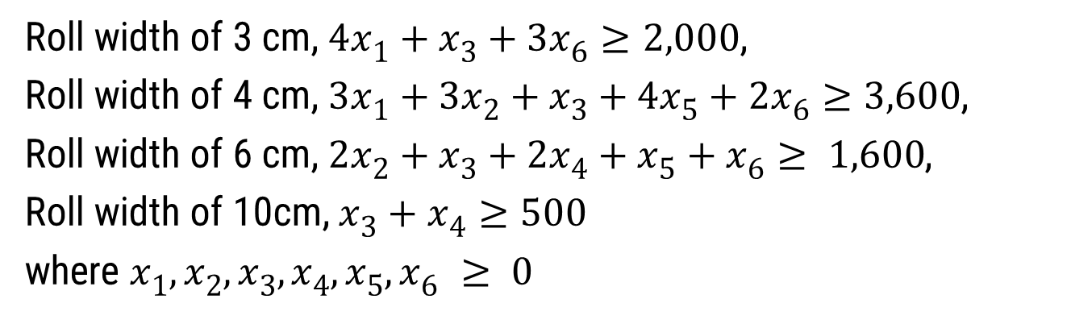
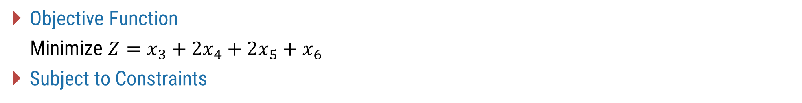
Problem 4 (Trim Loss Problem)
Let x₁, x₂, x₃, x₄, x₅ & x₆ represent the number of times each cutting alternative to be used.
Cutting alternatives | Width of rolls (cm) |  |  |  | Waste (cm)
 | 3 | 4 | 6 | 10
1 | 4 | 3 | - | - | -
2 | - | 3 | 2 | - | -
3 | 1 | 1 | 1 | 1 | 1
4 | - | - | 2 | 1 | 2
5 | - | 4 | 1 | - | 2
6 | 3 | 2 | 1 | - | 1
Objective Function
Minimize $Z=x_{3}+2x_{4}+2x_{5}+x_{6}$
Subject to Constraints
Roll width of 3 cm, $4x1+x3+3x6≥2,000$,
Roll width of 4 cm, $3x1+3x2+x3+4x5+2x6≥3,600$,
Roll width of 6 cm, $2x2+x3+2x4+x5+x6≥ 1,600$,
Roll width of 10cm, $x3+x4≥500$
where $x1, x2, x3, x4, x5, x6 ≥ 0$
Roll Width (cm) | 3 | 4 | 6 | 10
Demand | 2000 | 3600 | 1600 | 500

Slide 40
Practice Problem 1 : Problem Formulation
An IT company develops two types of software products: Product A (Mobile App) and Product B (Website). Each product requires developer hours and testing hours:
Formulate the Linear Programming Problem to maximize profit.
Resource | Product A (Mobile App) | Product B (Website) | Availability
Developer Hours | 3 | 4 | 240
Testing Hours | 2 | 3 | 180
Profit | ₹4,000 | ₹6,000

Slide 41
Practice Problem 2 : Problem Formulation
A software consultancy firm handles two types of client projects:
Project X: A custom E-commerce Website
Project Y: A custom AI Chatbot Integration
Each project requires time from, Frontend & Backend Development Team (Team A) and AI & Data Services Team (Team B).
Team | Project X | Project Y | Available Hours
Team A | 3 | 4 | 20
Team B | 4 | 5 | 26
Profit | ₹4,000 | ₹6,000
Each Project Y also produces 2 reusable code templates for AI components (say, libraries or APIs) at no extra effort.
Each unit of Project X brings a profit of ₹10,000.
Each unit of Project Y brings a profit of ₹20,000.
Each reusable AI template (by-product from Y) can be sold for ₹6,000, but only 5 templates can be sold.
Unsold templates incur a maintenance/storage cost of ₹4,000 per template.
Formulate the L.P. model to determine the quantities of X and Y (main product), keeping Z (side-product) in mind, to maximize the total profit.

Slide 42
Practice Problem 3 : Problem Formulation
An IT engineer is tasked with designing a cloud-based microservice platform by combining three different cloud modules:
Module A (Open-source microservice)
Module B (Standard commercial API)
Module C (High-performance cloud function)
The final software platform must meet the following specifications:
Average latency ≤ 0.98 seconds
Security rating ≥ 8 (on scale of 1 to 10)
Availability (uptime) ≥ 450 hours per month
Determine the proportions of A, B, and C to include in the final platform such that:
The platform meets all performance requirements
The total cost is minimized.
Property | Module A | Module B | Module C
Latency (sec) | 0.92 | 0.97 | 1.04
Security Rating | 7 | 13 | 16
Uptime (hours) | 440 | 490 | 480
Cost (₹/unit) | ₹90 | ₹280 | ₹40

Slide 43
The Simplex Method
Section – 1.4

Slide 44
Simplex Method
Simplex method, also called simplex technique or simplex algorithm was developed in 1947 by G.B. Dantzig, an American mathematician. It has the advantage of being universal, i.e., any linear model for which the solution exists, can be solved by it.
The simplex method is an algorithm that moves from one vertex of the feasible region to another in such a manner that the value of the objective function improves at each step.
This procedure of jumping from one vertex to another is then repeated. Since the number of vertices is finite, this method leads to an optimal vertex in a finite number of steps.
Let’s understand this with an example.

Slide 45
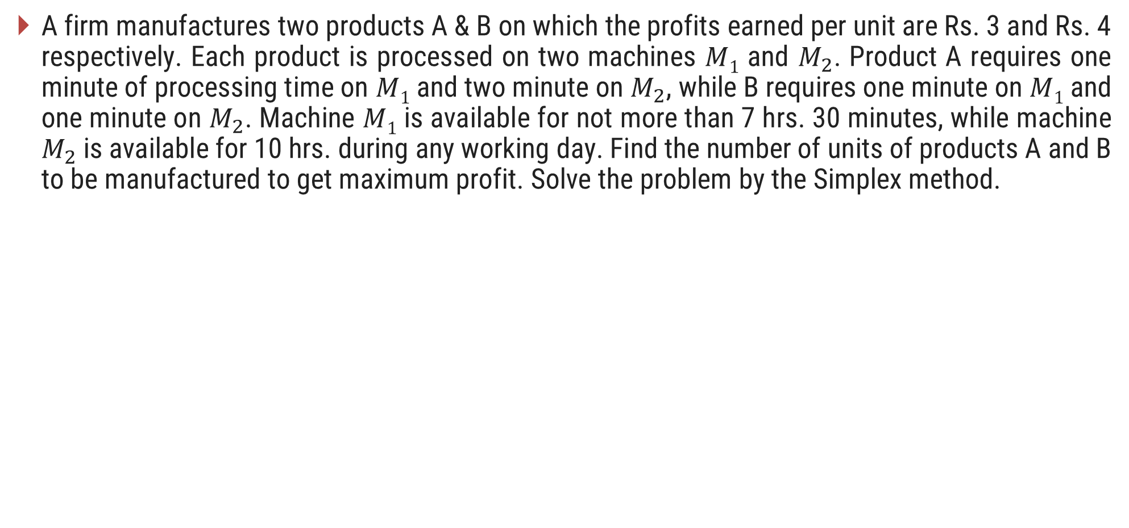
Example (Graphical Representation)
A firm manufactures two products A & B on which the profits earned per unit are Rs. 3 and Rs. 4 respectively. Each product is processed on two machines $M1$ and $M_{2}$. Product A requires one minute of processing time on $M1$ and two minute on $M_{2}$, while B requires one minute on $M1$ and one minute on $M_{2}$. Machine $M1$ is available for not more than 7 hrs. 30 minutes, while machine $M_{2}$ is available for 10 hrs. during any working day. Find the number of units of products A and B to be manufactured to get maximum profit. Solve the problem by the Simplex method.

Slide 46
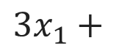


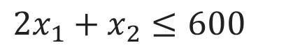
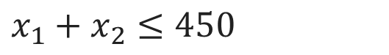
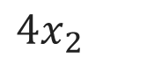
Example (Graphical Representation)
Step-1 : Formulation of the Mathematical Model
Machine | Machining Time (minutes) |  | Machine capacity (minutes/day)
 | Product A | Product B
M₁ | 1 | 1 | 450
M₂ | 2 | 1 | 600
Profit per unit | 3 | 4
Let x₁ and x₂ be the number of units of products, A and B produced per day.
Objective Function
Maximize,
$$Z=$$
$$3x_{1}+$$
$$4x_{2}$$
Subject to Constraints
$$x_{1}+x_{2}≤450$$
$$2x_{1}+x_{2}≤600$$
Non-negativity Constraint
where $x_{1}, x_{2}≥0$

Slide 47

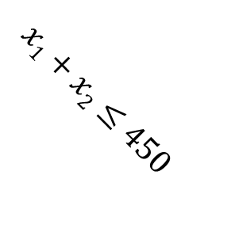
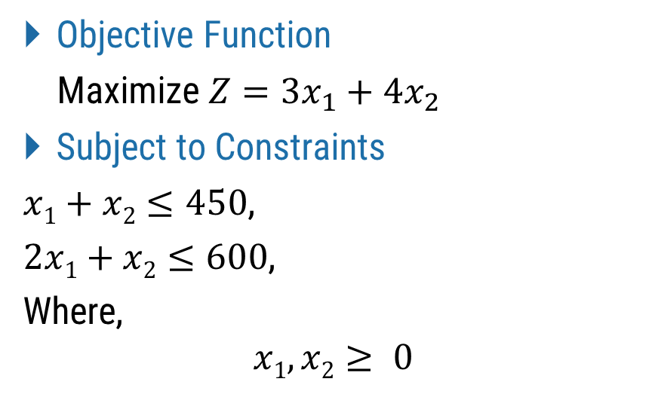
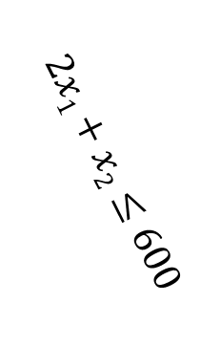
Objective Function
Maximize $Z={3x}_{1}+4x_{2}$
Subject to Constraints
$x1+x2≤450$,
$2x1+x2≤600$,
Where,
$$x1, x2≥ 0$$
X ₂
700
600
500
$$2x1+x2≤600$$
A
400
B
300
The Simplex Method starts with an initial solution (usually at the origin), then moves step-by-step from one corner point (vertex) of the feasible region to another, each time improving the value of the objective function, until the best (optimal) solution is found.
200
Feasible
Region
$x1+x2≤450$
100
C
O
O
100
200
300
400
500
600
700
X ₁

Slide 48
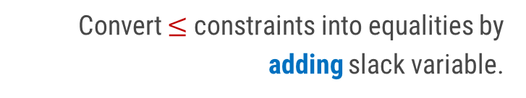
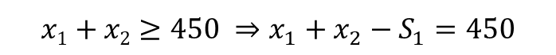
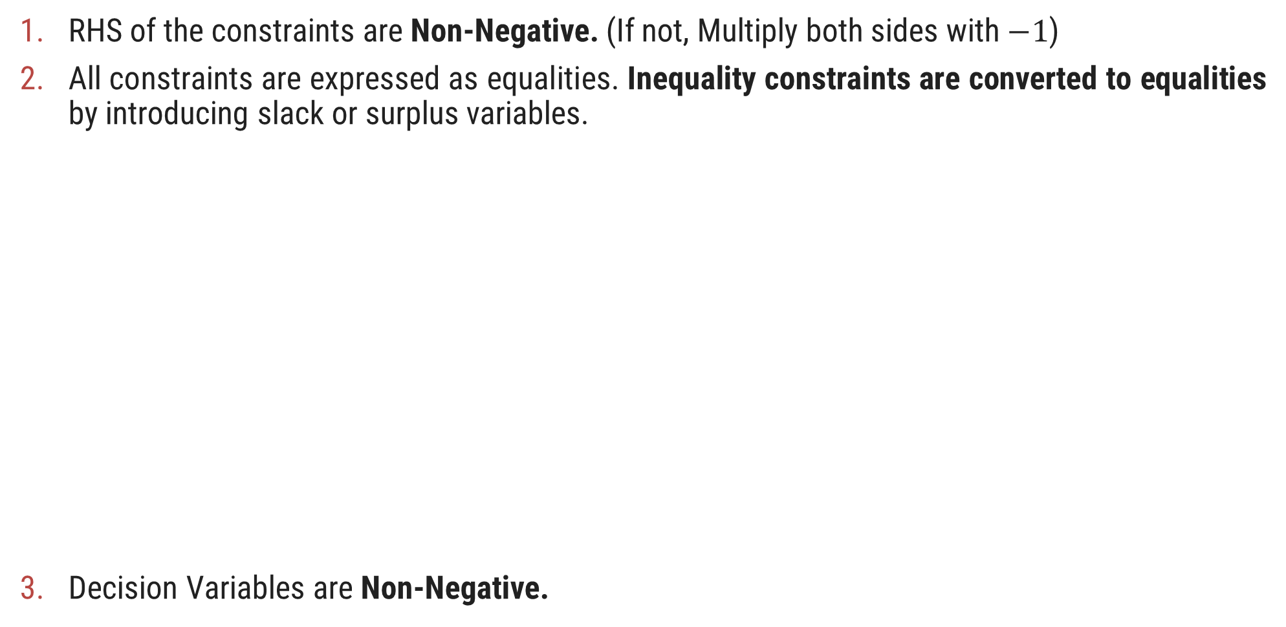
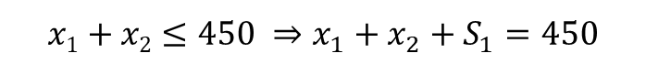
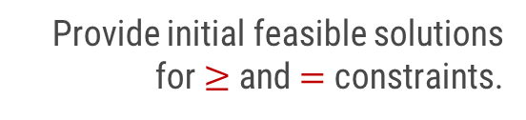
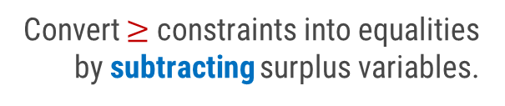
Simplex Method: Standard Form
RHS of the constraints are Non-Negative. (If not, Multiply both sides with $−1$)
All constraints are expressed as equalities. Inequality constraints are converted to equalities by introducing slack or surplus variables.
Decision Variables are Non-Negative.
Convert $≤$ constraints into equalities by adding slack variable.
Slack Variables
$$x1+x2≤450 ⇒x_{1}+x_{2}+S_{1}=450$$
Convert $≥$ constraints into equalities by subtracting surplus variables.
Surplus Variables
Equality Constraints
$$x1+x2≥450 ⇒x_{1}+x_{2}−S_{1}=450$$
Provide initial feasible solutions for $≥$ and $=$ constraints.
Artificial Variables

Slide 49
Steps to Solve the Problem using Simplex Method
Formulation of the Mathematical Model
Express the Problem in a Standard Form
RHS of the constraints are non-negative
The constraints should be expressed as equations
Decision variables are non-negative
Find Initial Basic Feasible Solution
Prepare Simplex Table
Perform Optimality Test
If not Optimum, Iterate Towards an Optimal Solution

Slide 50
Problem – 5 Simplex Method
A firm manufactures two products A & B on which the profits earned per unit are Rs. 3 and Rs. 4 respectively. Each product is processed on two machines $M1$ and $M_{2}$. Product A requires one minute of processing time on $M1$ and two minute on $M_{2}$, while B requires one minute on $M1$ and one minute on $M_{2}$. Machine $M1$ is available for not more than 7 hrs. 30 minutes, while machine $M_{2}$ is available for 10 hrs. during any working day. Find the number of units of products A and B to be manufactured to get maximum profit. Solve the problem by the Simplex method.

Slide 51
Problem – 5 Simplex Method
Step-1 : Formulation of the Mathematical Model
Machine | Machining Time (minutes) |  | Machine capacity (minutes/day)
 | Product A | Product B
M₁ | 1 | 1 | 450
M₂ | 2 | 1 | 600
Profit per unit | 3 | 4
Let x₁ and x₂ be the number of units of products, A and B produced per day.
Objective Function
Maximize,
$$Z=$$
$$3x_{1}+$$
$$4x_{2}$$
Subject to Constraints
$$x_{1}+x_{2}≤450$$
$$2x_{1}+x_{2}≤600$$
Non-negativity Constraint
where $x_{1}, x_{2}≥0$

Slide 52
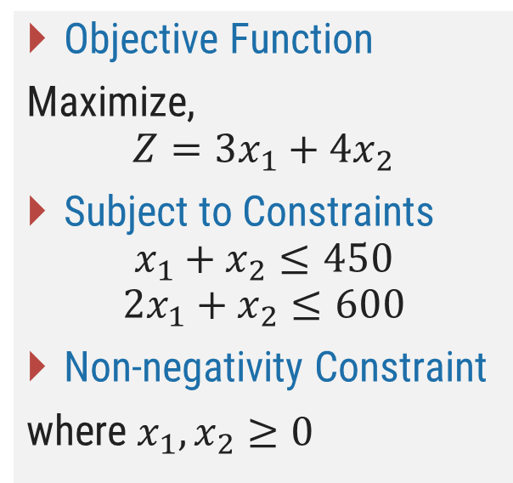


Problem – 5 Simplex Method
Step-2 : Express the Problem in a Standard Form
The given problem is said to be expressed in standard form if
The constraints should be expressed as equations
RHS of the constraints are non-negative
Decision variables are non-negative
Slack variables $S_{1}$ and $S_{2}$ are added to the LHS of the constraints to convert them into equations.
Objective Function
Maximize,
$$Z=3x_{1}+4x_{2}$$
Subject to Constraints
$$x_{1}+x_{2}≤450$$
$$2x_{1}+x_{2}≤600$$
Non-negativity Constraint
where $x_{1}, x_{2}≥0$
Therefore,
$$x_{1}+x_{2}+S_{1}=450$$
$$2x_{1}+x_{2}+S_{2}=600$$
Slack variables represent unutilized capacity or resources.
Here, $S_{1}$and $S_{2}$ represent the time (in minute) for which machine $M_{1}$ and $M_{2}$ remains unutilised or idle.

Slide 53

Problem – 5 Simplex Method
The problem in standard form can be written as
Objective Function
Maximize,
$$Z=3x_{1}+4x_{2}+0S_{1}+0S_{2}$$
Subject to constraints
$$x_{1}+x_{2}+S_{1}=450$$
$$2x_{1}+x_{2}+S_{2}=600$$
Where,
$$x_{1}, x_{2},S_{1}, S_{2}≥0$$
Objective Function
Maximize,
$$Z=3x_{1}+4x_{2}$$
Subject to Constraints
$$x_{1}+x_{2}≤450$$
$$2x_{1}+x_{2}≤600$$
Non-negativity Constraint
where $x_{1}, x_{2}≥0$
Slack variables represent idle recourses, they contribute Zero to the Objective Function.

Slide 54


Problem – 5 Simplex Method
Step-3 : Find the Initial Basic Feasible Solution
In a simplex method start is made with a feasible solution, which we shall get by assuming that the profit earned is zero.
So, the decision variables, $x_{1}$ and $x_{2}$ should be taken as Zero. These variables are called Non-basic Variables.
Substituting $x_{1}=x_{2}=0$ in the constraints to get the Basic Variables $S_{1}$ and $S_{2}$.
Therefore,
$$S_{1}=450$$
$$S_{2}=600$$
and hence,
$$Z=0$$
Which is called the Initial Basic Feasible Solution.
Standard Form
Objective Function
Maximize,
$$Z=3x_{1}+4x_{2}+0S_{1}+0S_{2}$$
Subject to Constraints
$$x_{1}+x_{2}+S_{1}=450$$
$$2x_{1}+x_{2}+S_{2}=600$$
Non-negativity Constraint
Where $x_{1}, x_{2},S_{1}, S_{2}≥0$

Slide 55


























Problem – 5 Simplex Method
Step-4 : Prepare a Simplex Table
The initial basic feasible solution obtained and the problem in standard form can be expressed in the form of a table, called Simplex Table.
Standard Form
Objective Function
Maximize,
$$Z=3x_{1}+4x_{2}+0S_{1}+0S_{2}$$
Subject to Constraints
$$x_{1}+x_{2}+S_{1}=450$$
$$2x_{1}+x_{2}+S_{2}=600$$
Non-negativity Constraint
Where $x_{1}, x_{2},S_{1}, S_{2}≥0$
Initial Basic Feasible Solution
$$S_{1}=450$$
$$S_{2}=600$$
$$Z=0$$
Body Matrix
Identity Matrix
$$C_{j}$$
(Contribution Units)
$$3$$
$$4$$
$$0$$
$$0$$
$$C_{B}$$
(Co-efficient of
Basic Variables)
$$b$$
(Solution Value
Column)
Basis
(Basic Variables)
$$x_{1}$$
$$x_{2}$$
$$S_{1}$$
$$S_{2}$$
$$0$$
$$S_{1}$$
$$1$$
$$1$$
$$1$$
$$0$$
$$450$$
$$0$$
$$S_{2}$$
$$2$$
$$1$$
$$0$$
$$1$$
$$600$$

Slide 56







































Problem – 5 Simplex Method
Step-5 : Perform Optimality Test
The next step is to check whether the initial basic feasible solution found can be improved or not?
$Z_{j}$ represents the current contribution to the objective function from the respective variables.
${C_{j}−Z}_{j}$ row is called index row or Net Evaluation Row (NER). It shows the net effect (profit or loss) per unit if we include a non-basic variable into the current solution.
${C_{j}−Z}_{j}$ also determines whether the current solution is optimal or not.
$$C_{j}$$
$$3$$
$$4$$
$$0$$
$$0$$
$$Z_{j}=\sum{C_{B}a_{ij}}$$
$$C_{B}$$
Basis
$$x_{1}$$
$$x_{2}$$
$$S_{1}$$
$$S_{2}$$
$$b$$
$$0$$
$$S_{1}$$
$$1$$
$$1$$
$$1$$
$$0$$
$$450$$
Where,
$a_{ij}=$ Matrix element in the i^{th} row and j^{th} column
$$0$$
$$S_{2}$$
$$2$$
$$1$$
$$0$$
$$1$$
$$600$$
$$Z_{j}$$
$$0$$
$$0$$
$$0$$
$$0$$
$$0$$
$${C_{j}−Z}_{j}$$
$$3$$
$$4$$
$$0$$
$$0$$

Slide 57





































Problem – 5 Simplex Method
$$C_{j}$$
$$3$$
$$4$$
$$0$$
$$0$$
$$C_{B}$$
Basis
$$x_{1}$$
$$x_{2}$$
$$S_{1}$$
$$S_{2}$$
$$b$$
$$0$$
$$S_{1}$$
$$1$$
$$1$$
$$1$$
$$0$$
$$450$$
$$0$$
$$S_{2}$$
$$2$$
$$1$$
$$0$$
$$1$$
$$600$$
$$Z_{j}$$
$$0$$
$$0$$
$$0$$
$$0$$
$$0$$
$${C_{j}−Z}_{j}$$
$$3$$
$$4$$
$$0$$
$$0$$
The co-efficient in the $C_{j}−Z_{j}$ row represent the net contribution in the value of the objective function for each unit of the respective column variable introduced into the solution.
For Maximization problem, if the element in the $C_{j}−Z_{j}$ row are zero or negative, the current solution is optimal.
In case, any element is positive, it is not optimal and there is scope for improvement.

Slide 58






































Problem – 5 Simplex Method
Step-6 : Iterate towards an Optimal Solution
Selection of Entering Variable: Observe $C_{j}−Z_{j}$ row and mark the column whose variable will enter the basis.
For Maximization Problem: Select the Most Positive value of $C_{j}−Z_{j}$
For Minimization Problem: Select the Most Negative value of $C_{j}−Z_{j}$
The selected column is called the Key Column (K). For maximization problem, if more than one variable have same maximum value, any one of them can be selected.
$$C_{j}$$
$$3$$
$$4$$
$$0$$
$$0$$
$$C_{B}$$
Basis
$$x_{1}$$
$$x_{2}$$
$$S_{1}$$
$$S_{2}$$
$$b$$
$x_{2}$ is the entering variable and hence it will enter the basis in the next step
$$0$$
$$S_{1}$$
$$1$$
$$1$$
$$1$$
$$0$$
$$450$$
$$0$$
$$S_{2}$$
$$2$$
$$1$$
$$0$$
$$1$$
$$600$$
$$Z_{j}$$
$$0$$
$$0$$
$$0$$
$$0$$
$$0$$
$${C_{j}−Z}_{j}$$
$$3$$
$$4$$
$$0$$
$$0$$
$K$ (Key Column)

Slide 59






Problem – 5 Simplex Method
Step-6 : Iterate towards an Optimal Solution
Selection of Leaving Variable: Find Minimum Ratio $\left(θ\right)$ by dividing $b$ column with the corresponding elements of the key column $(K)$.
The row with the smallest non-negative ratio is marked as key row (Zero is considered as non-negative) and the corresponding variable is called leaving variable.
In case, all ratios are negative or infinity, the solution is Unbounded.
$S_{1}$ is the leaving variable and hence it will leave the basis in the next step
$$C_{j}$$
$$3$$
$$4$$
$$0$$
$$0$$
$$C_{B}$$
Basis
$$x_{1}$$
$$x_{2}$$
$$S_{1}$$
$$S_{2}$$
$$b$$
$$θ=b/K$$
$$0$$
$$S_{1}$$
$$1$$
$$1$$
$$1$$
$$0$$
$$450$$
$$450$$
Key Row
The element lying at the intersection of key column and key row is called Key Element.
$$0$$
$$S_{2}$$
$$2$$
$$1$$
$$0$$
$$1$$
$$600$$
$$600$$
$$Z_{j}$$
$$0$$
$$0$$
$$0$$
$$0$$
$$0$$
$${C_{j}−Z}_{j}$$
$$3$$
$$4$$
$$0$$
$$0$$
$$K$$

Slide 60







































Problem – 5 Simplex Method
Step-7 : Evaluating the New Solution
$x_{2}$ will enter the basis and $S_{1}$ will leave the basis in the new table.
Perform row operations to make the key element equal to 1 and all other elements in the key column equal to 0 using key element.
$$C_{j}$$
$$3$$
$$4$$
$$0$$
$$0$$
$$C_{B}$$
Basis
$$x_{1}$$
$$x_{2}$$
$$S_{1}$$
$$S_{2}$$
$$b$$
$$Z_{j}=\sum{C_{B}a_{ij}}$$
$$4$$
$$x_{2}$$
$$1$$
$$1$$
$$1$$
$$0$$
$$450$$
$$0$$
$$S_{2}$$
$$1$$
$$0$$
$$−1$$
$$1$$
$$150$$
$$Z_{j}$$
$$4$$
$$4$$
$$4$$
$$0$$
$$1800$$
$${C_{j}−Z}_{j}$$
$$−1$$
$$0$$
$$−4$$
$$0$$
For a given Maximization problem, all the element in the $C_{j}−Z_{j}$ row are zero or negative, hence the current solution is optimal.

Slide 61





































Problem – 5 Simplex Method
$$C_{j}$$
$$3$$
$$4$$
$$0$$
$$0$$
The slack variable $S_{1}=0$, means the capacity of machine $M_{1}$ is fully utilized.
The slack variable $S_{2}=150$, means the capacity of machine $M_{2}$ remain unutilised for 150 minutes.
Elements in $C_{j}−Z_{j}$ row under slack variables indicate the shadow prices of the resources of m/c $M_{1}$ & $M_{2}$.
$−4$ under variable $S_{1}$ column means that if the time available on m/c $M_{1}$ is used a minute less, the profit will be decreased by ₹4. In other words, if $M_{1}$ is available for a minute more, the profit will increase by ₹4.
Therefore, if the company wants to increase its resource capacities, it should be for m/c $M_{1}$, not $M_{2}$, since it is not utilized fully so there will be no use increasing it further.
$$C_{B}$$
Basis
$$x_{1}$$
$$x_{2}$$
$$S_{1}$$
$$S_{2}$$
$$b$$
$$4$$
$$x_{2}$$
$$1$$
$$1$$
$$1$$
$$0$$
$$450$$
$$0$$
$$S_{2}$$
$$1$$
$$0$$
$$−1$$
$$1$$
$$150$$
$$Z_{j}$$
$$4$$
$$4$$
$$4$$
$$0$$
$$1800$$
$${C_{j}−Z}_{j}$$
$$−1$$
$$0$$
$$−4$$
$$0$$
Hence, the Optimal Solution is:
$$x_{1}=0$$
$$x_{2}=450$$
$$S_{1}=0$$
$$S_{2}=150$$
$$Z_{max}=3x_{1}+4x_{2}+0S_{1}+0S_{2}=₹1800$$

Slide 62

Problem – 6 Simplex Method
Use Simplex method to solve the following linear programming problem:
Maximize $Z={2x}_{1}+5x_{2},$
Subject to,
$$x_{1}+{4x}_{2}≤24,$$
$${3x}_{1}+x_{2}≤21,$$
$$x_{1}+x_{2}≤9,$$
$$x_{1},x_{2}≥0.$$
Step-1 : Mathematical Form
Problem is already given in the mathematical form.

Slide 63


Problem – 6 Simplex Method
Step-2 : Standard Form
The problem in standard form can be written as
Objective Function
Maximize,
$$Z=2x_{1}+5x_{2}+0S_{1}+0S_{2}+0S_{3}$$
Subject to constraints
$$x_{1}+{4x}_{2}+S_{1}=24$$
$${3x}_{1}+x_{2}+S_{2}=21$$
$$x_{1}+x_{2}+S_{3}=9$$
Where,
$$x_{1}, x_{2},S_{1}, S_{2},S_{3}≥0$$
Step-3 : Initial Basic Feasible Solution
Substituting $x_{1}=x_{2}=0$ in the constraints to get the Basic Variables $S_{1}$, $S_{2}$ and $S_{3}$.
Therefore,
$$S_{1}=24$$
$$S_{2}=21$$
$$S_{3}=9$$
and hence,
$$Z=0$$

Slide 64























































Problem – 6 Simplex Method
Step-4 : Prepare a Simplex Table & Perform Optimality Test
Standard Form
Objective Function
Maximize,
$$Z=2x_{1}+5x_{2}+0S_{1}+0S_{2}+0S_{3}$$
Subject to Constraints
$$x_{1}+{4x}_{2}+S_{1}=24$$
$${3x}_{1}+x_{2}+S_{2}=21$$
$$x_{1}+x_{2}+S_{3}=9$$
Non-negativity Constraint
Where $x_{1}, x_{2},S_{1}, S_{2},S_{3}≥0$
Initial Basic Feasible Solution
$$S_{1}=24$$
$$S_{2}=21$$
$$S_{3}=9$$
$$Z=0$$
$$C_{j}$$
$$2$$
$$5$$
$$0$$
$$0$$
$$0$$
$$C_{B}$$
Basis
$$x_{1}$$
$$x_{2}$$
$$S_{1}$$
$$S_{2}$$
$$S_{3}$$
$$b$$
$$θ=b/K$$
$$0$$
$$S_{1}$$
$$1$$
$$4$$
$$1$$
$$0$$
$$0$$
$$24$$
$$6$$
Key Row
$$0$$
$$S_{2}$$
$$3$$
$$1$$
$$0$$
$$1$$
$$0$$
$$21$$
$$21$$
$$0$$
$$S_{3}$$
$$1$$
$$1$$
$$0$$
0
$$1$$
$$9$$
$$9$$
$$Z_{j}$$
$$0$$
$$0$$
$$0$$
$$0$$
$$0$$
$$0$$
$${C_{j}−Z}_{j}$$
$$2$$
$$5$$
$$0$$
$$0$$
$$0$$
$$K$$

Slide 65























































Step-5 : Iterate Towards Optimal Solution
$$C_{j}$$
$$2$$
$$5$$
$$0$$
$$0$$
$$0$$
$$C_{B}$$
Basis
$$x_{1}$$
$$x_{2}$$
$$S_{1}$$
$$S_{2}$$
$$S_{3}$$
$$b$$
$$θ=b/K$$
$$5$$
$$x_{2}$$
$$1/4$$
$$1$$
$$1/4$$
$$0$$
$$0$$
$$6$$
$$24$$
$$0$$
$$S_{2}$$
$$11/4$$
$$0$$
$$−1/4$$
$$1$$
$$0$$
$$15$$
$$60/11$$
$$0$$
$$S_{3}$$
$$3/4$$
$$0$$
$$−1/4$$
0
$$1$$
$$3$$
$$4$$
Key Row
$$Z_{j}$$
$$5/4$$
$$5$$
$$5/4$$
$$0$$
$$0$$
$$30$$
$${C_{j}−Z}_{j}$$
$$3/4$$
$$0$$
$$−5/4$$
$$0$$
$$0$$
$$K$$
Make key element 1 by dividing entire row with 4.
Use key element to make other elements of key column zero.

Slide 66
























Step-5 : Iterate Towards Optimal Solution
$$C_{j}$$
$$2$$
$$5$$
$$0$$
$$0$$
$$0$$
$$C_{B}$$
Basis
$$x_{1}$$
$$x_{2}$$
$$S_{1}$$
$$S_{2}$$
$$S_{3}$$
$$b$$
$$5$$
$$x_{2}$$
$$0$$
$$1$$
$$1/3$$
$$0$$
$$−1/3$$
$$5$$
$$0$$
$$S_{2}$$
$$0$$
$$0$$
$$2/3$$
$$1$$
$$−11/3$$
$$4$$
$$2$$
$$x_{1}$$
$$1$$
$$0$$
$$−1/3$$
0
$$4/3$$
$$4$$
$$Z_{j}$$
$$2$$
$$5$$
$$1$$
$$0$$
$$1$$
$$33$$
$${C_{j}−Z}_{j}$$
$$0$$
$$0$$
$$−1$$
$$0$$
$$−1$$
Make key element 1 by multiplying entire row with $4/3$.
Use key element to make other elements of key column zero.
For Maximization problem, if the element in the $C_{j}−Z_{j}$ row are zero or negative, the current solution is optimal.

Slide 67


















































Problem – 6 Simplex Method
$$C_{j}$$
$$2$$
$$5$$
$$0$$
$$0$$
$$0$$
Hence, the Optimal Solution is:
$$x_{1}=4$$
$$x_{2}=5$$
$$S_{1}=0$$
$$S_{2}=4$$
$$S_{3}=0$$
$$Z_{max}=2x_{1}+5x_{2}+0S_{1}+0S_{2}+0S_{3}$$
$$∴Z_{max}=33$$
$$C_{B}$$
Basis
$$x_{1}$$
$$x_{2}$$
$$S_{1}$$
$$S_{2}$$
$$S_{3}$$
$$b$$
$$5$$
$$x_{2}$$
$$0$$
$$1$$
$$1/3$$
$$0$$
$$−1/3$$
$$5$$
$$0$$
$$S_{2}$$
$$0$$
$$0$$
$$2/3$$
$$1$$
$$−11/3$$
$$4$$
$$2$$
$$x_{1}$$
$$1$$
$$0$$
$$−1/3$$
0
$$4/3$$
$$4$$
$$Z_{j}$$
$$2$$
$$5$$
$$1$$
$$0$$
$$1$$
$$33$$
$${C_{j}−Z}_{j}$$
$$0$$
$$0$$
$$−1$$
$$0$$
$$−1$$

Slide 68

Problem – 7 Simplex Method
Use Simplex method to solve the following linear programming problem:
Minimize $Z=x_{1}−3x_{2}+3x_{3},$
Subject to,
$$3x_{1}−x_{2}+2x_{3}≤7,$$
$${2x}_{1}+{4x}_{2}≥−12,$$
$${−4x}_{1}+3x_{2}+8x_{3}≤10,$$
$$x_{1},x_{2},x_{3}≥0.$$
Step-1 : Mathematical Form
Problem is already given in the mathematical form.

Slide 69


Problem – 7 Simplex Method
Step-2 : Standard Form
RHS of 2nd constraint is negative, i.e.
$${2x}_{1}+{4x}_{2}≥−12$$
So make it non-negative by multiplying with $−1$
$$∴{−2x}_{1}−{4x}_{2}≤12$$
The problem in standard form can be written as
Minimize,
$$Z=x_{1}−3x_{2}+3x_{3}+0S_{1}+0S_{2}+0S_{3}$$
Subject to constraints
$${3x}_{1}−x_{2}+2x_{3}+S_{1}=7$$
$${−2x}_{1}−{4x}_{2}+S_{2}=12$$
$${−4x}_{1}+{3x}_{2}+8x_{3}+S_{3}=10$$
$$x_{1}, x_{2},x_{3},S_{1}, S_{2},S_{3}≥0$$
Step-3 : Initial Basic Feasible Solution
Substituting $x_{1}=x_{2}=x_{3}=0$ in the constraints to get the Basic Variables $S_{1}$, $S_{2}$ and $S_{3}$.
Therefore,
$$S_{1}=7$$
$$S_{2}=12$$
$$S_{3}=10$$
and hence,
$$Z=0$$

Slide 70






























































Problem – 7 Simplex Method
Step-4 : Prepare a Simplex Table & Perform Optimality Test
Standard Form
Objective Function
Minimize,
$$Z=x_{1}−3x_{2}+3x_{3}+0S_{1}+0S_{2}+0S_{3}$$
Subject to Constraints
$${3x}_{1}−x_{2}+2x_{3}+S_{1}=7$$
$${−2x}_{1}−{4x}_{2}+S_{2}=12$$
$${−4x}_{1}+{3x}_{2}+8x_{3}+S_{3}=10$$
Non-negativity Constraint
Where $x_{1}, x_{2},x_{3},S_{1}, S_{2},S_{3}≥0$
Initial Basic Feasible Solution
$$S_{1}=7$$
$$S_{2}=12$$
$$S_{3}=10$$
$$Z=0$$
$$C_{j}$$
$$1$$
$$−3$$
$$3$$
$$0$$
$$0$$
$$0$$
$$C_{B}$$
Basis
$$x_{1}$$
$$x_{2}$$
$$x_{3}$$
$$S_{1}$$
$$S_{2}$$
$$S_{3}$$
$$b$$
$$θ=b/K$$
$$0$$
$$S_{1}$$
$$3$$
$$−1$$
$$2$$
$$1$$
$$0$$
$$0$$
$$7$$
$$−7$$
$$0$$
$$S_{2}$$
$$−2$$
$$−4$$
$$0$$
$$0$$
$$1$$
$$0$$
$$12$$
$$−3$$
$$0$$
$$S_{3}$$
$$−4$$
$$3$$
$$8$$
$$0$$
0
$$1$$
$$10$$
$$10/3$$
Key Row
$$Z_{j}$$
$$0$$
$$0$$
$$0$$
$$0$$
$$0$$
$$0$$
$$0$$
$${C_{j}−Z}_{j}$$
$$1$$
$$−3$$
$$3$$
$$0$$
$$0$$
$$0$$
$$K$$
For Minimization, select the column with most negative $C_{j}−Z_{j}$ value for entering variable.

Slide 71






























































Step-4 : Prepare a Simplex Table & Perform Optimality Test
$$C_{j}$$
$$1$$
$$−3$$
$$3$$
$$0$$
$$0$$
$$0$$
$$C_{B}$$
Basis
$$x_{1}$$
$$x_{2}$$
$$x_{3}$$
$$S_{1}$$
$$S_{2}$$
$$S_{3}$$
$$b$$
$$θ=b/K$$
$$0$$
$$S_{1}$$
$$5/3$$
$$0$$
$$14/3$$
$$1$$
$$0$$
$$1/3$$
$$31/3$$
$$31/5$$
Key Row
$$0$$
$$S_{2}$$
$$−22/3$$
$$0$$
$$32/3$$
$$0$$
$$1$$
$$4/3$$
$$76/3$$
$$−38/11$$
$$−3$$
$$x_{2}$$
$$−4/3$$
$$1$$
$$8/3$$
$$0$$
0
$$1/3$$
$$10/3$$
$$−5/2$$
$$Z_{j}$$
$$4$$
$$−3$$
$$−8$$
$$0$$
$$0$$
$$−1$$
$$−10$$
$${C_{j}−Z}_{j}$$
$$−3$$
$$0$$
$$11$$
$$0$$
$$0$$
$$1$$
$$K$$
Make key element 1 by dividing entire row with 3.
Use key element to make other elements of key column zero.

Slide 72























































Step-4 : Prepare a Simplex Table & Perform Optimality Test
$$C_{j}$$
$$1$$
$$−3$$
$$3$$
$$0$$
$$0$$
$$0$$
$$C_{B}$$
Basis
$$x_{1}$$
$$x_{2}$$
$$x_{3}$$
$$S_{1}$$
$$S_{2}$$
$$S_{3}$$
$$b$$
$$1$$
$$x_{1}$$
$$1$$
$$0$$
$$14/5$$
$$3/5$$
$$0$$
$$1/5$$
$$31/5$$
$$0$$
$$S_{2}$$
$$0$$
$$0$$
$$156/5$$
$$22/5$$
$$1$$
$$14/5$$
$$354/5$$
$$−3$$
$$x_{2}$$
$$0$$
$$1$$
$$32/5$$
$$4/5$$
0
$$3/5$$
$$58/5$$
$$Z_{j}$$
$$1$$
$$−3$$
$$−82/5$$
$$−9/5$$
$$0$$
$$−8/5$$
$$−143/5$$
$${C_{j}−Z}_{j}$$
$$0$$
$$0$$
$$97/5$$
$$9/5$$
$$0$$
$$8/5$$
Make key element 1 by multiplying entire row with 3/5.
Use key element to make other elements of key column zero.
For Minimization problem, if the element in the $C_{j}−Z_{j}$ row are zero or positive, the current solution is optimal.

Slide 73

























































Problem – 7 Simplex Method
$$C_{j}$$
$$1$$
$$−3$$
$$3$$
$$0$$
$$0$$
$$0$$
Hence, the Optimal Solution is:
$$x_{1}=31/5$$
$$x_{2}=58/5$$
$$x_{3}=0$$
$$S_{1}=0$$
$$S_{2}=354/5$$
$$S_{3}=0$$
$$Z_{min}=x_{1}−3x_{2}+3x_{3}+0S_{1}+0S_{2}+0S_{3}$$
$$∴Z_{min}=−143/5$$
$$C_{B}$$
Basis
$$x_{1}$$
$$x_{2}$$
$$x_{3}$$
$$S_{1}$$
$$S_{2}$$
$$S_{3}$$
$$b$$
$$1$$
$$x_{1}$$
$$1$$
$$0$$
$$14/5$$
$$3/5$$
$$0$$
$$1/5$$
$$31/5$$
$$0$$
$$S_{2}$$
$$0$$
$$0$$
$$156/5$$
$$22/5$$
$$1$$
$$14/5$$
$$354/5$$
$$−3$$
$$x_{2}$$
$$0$$
$$1$$
$$32/5$$
$$4/5$$
0
$$3/5$$
$$58/5$$
$$Z_{j}$$
$$1$$
$$−3$$
$$−82/5$$
$$−9/5$$
$$0$$
$$−8/5$$
$$−143/5$$
$${C_{j}−Z}_{j}$$
$$0$$
$$0$$
$$97/5$$
$$9/5$$
$$0$$
$$8/5$$

Slide 74
Artificial Variable Techniques
Section – 1.5

Slide 75


Introduction to Artificial Variable Techniques
Artificial variable techniques are used in equality constraints $(=)$ or “$≥$” type constraints.
Artificial Variables are used to start the simplex method when an initial basic feasible solution is not readily available.
i.e.
$$6x_{1}+8x_{2}−S_{1}+A_{1}=100$$
But artificial variables with values greater than zero violates the equality constraints and also it does not represent any real-world quantities.
Therefore, Artificial Variables must be removed from the final solution.
Example:
If we find the slack variable for the following constraint
$${6x}_{1}+{8x}_{2}≥100$$
i.e.
$$6x_{1}+8x_{2}−S_{1}=100$$
By putting, $x_{1}=x_{2}=0$
We get,
$$S_{1}=−100$$
Which violates the Non-negativity constraints that,
$$x_{1}, x_{2}, S_{1}≥0$$
So we can not start the simplex method with this non-feasible solution.

Slide 76

Techniques to Handle the Artificial Variables
There are two techniques to solve such problems
Big-M Method or M-Technique or Method of Penalties
Add a large penalty $(M)$ to Artificial variable in the objective function to ensure that the artificial variables are driven to Zero.
Minimization: $+M$
Maximization: $−M$
Two-Phase Method
Solve in two phases.
Phase-1: Minimize the Artificial Variable sum i.e. Minimize $Z=A_{1}+A_{2} + . . . .$
Phase-2 : Solve the Original Problem using Phase-1 Solution.

Slide 77






Problem – 8 Big-M Method
Food X contains 6 units of vitamin A per gram & 7 units vitamin B per gram and costs 12 paise per gram. Food Y contains 8 units of vitamin A per gram & 12 units of vitamin B per gram and costs 20 paise per gram. The daily minimum requirement of vitamin A and vitamin B is 100 units and 120 units respectively. Find the minimum cost of product mix by the simplex method.
Step-1 : Formulation of the Mathematical Model
Let $x1$ and $x2$ be the grams of food, X and Y to be purchased.
Objective Function
Minimize,
$$Z=$$
$$12x_{1}+$$
$$20x_{2}$$
Subject to Constraints
$${6x}_{1}+{8x}_{2}≥100$$
$$7x_{1}+{12x}_{2}≥120$$
Non-negativity Constraint
$$x_{1}, x_{2}≥0$$

Slide 78



Problem – 8 Big-M Method
Step-2 : Standard Form
Objective Function
Minimize,
$$Z={12x}_{1}+20x_{2}+0S_{1}+0S_{2}$$
Subject to constraints
$${6x}_{1}+8x_{2}−S_{1}=100$$
$${7x}_{1}+12x_{2}−S_{2}=120$$
$$x_{1}, x_{2},S_{1}, S_{2}≥0$$
Which is not feasible because, it does not satisfy the non-negativity constraint i.e.
$$x_{1}, x_{2},S_{1}, S_{2}≥0$$
Therefore, introducing Artificial Variables $A_{1}$and $A_{2}$ in the constraints.
$${6x}_{1}+8x_{2}−S_{1}+A_{1}=100$$
$${7x}_{1}+12x_{2}−S_{2}+A_{2}=120$$
$$x_{1}, x_{2},S_{1}, S_{2},A_{1}, A_{2}≥0$$
But artificial variables with values greater than zero violates the equality constraints.
Therefore, $A_{1}$and $A_{2}$ should not appear in the final solution.
Step-3 : Initial Basic Feasible Solution
Substituting $x_{1}=x_{2}=0$ in the constraints to get the Basic Variables $S_{1}$and $S_{2}$.
Therefore,
$$S_{1}=−100$$
$$S_{2}=−120$$

Slide 79

Problem – 8 Big-M Method
To remove the artificial variables from the final solution, they are assigned a large unit penalty in the objective function.
For Minimization problem assign $+M$
For Maximization problem assign $−M$
For the given problem of minimization, the Objective Function is
Minimize,
$$Z=12x_{1}+20x_{2}+0S_{1}+0S_{2}+MA_{1}+MA_{2}$$
Substituting $x_{1}=x_{2}=S_{1}=S_{2}=0$ in the constraints to get the Basic Variables $A_{1}$and $A_{2}$.
Therefore,
$$A_{1}=100$$
$$A_{2}=120$$
$$Z=220M$$
Which is called the Initial Basic Feasible Solution.
We are starting with the very heavy cost, which we shall minimize.

Slide 80

Problem – 8 Big-M Method
To achieve this Objective Function
Minimize,
$$Z={12x}_{1}+20x_{2}+0S_{1}+0S_{2}$$
Subject to constraints
$${6x}_{1}+8x_{2}−S_{1}=100$$
$${7x}_{1}+12x_{2}−S_{2}=120$$
$$x_{1}, x_{2},S_{1}, S_{2}≥0$$
Which is not feasible because, it does not satisfy the non-negativity constraint i.e.
$$x_{1}, x_{2},S_{1}, S_{2}≥0$$
Therefore, introducing Artificial Variables $A_{1}$and $A_{2}$ in the constraints.
$${6x}_{1}+8x_{2}−S_{1}+A_{1}=100$$
$${7x}_{1}+12x_{2}−S_{2}+A_{2}=120$$
$$x_{1}, x_{2},S_{1}, S_{2},A_{1}, A_{2}≥0$$
But artificial variables with values greater than zero violates the equality constraints.
Therefore, $A_{1}$and $A_{2}$ should not appear in the final solution.
Step-3 : Initial Basic Feasible Solution
Substituting $x_{1}=x_{2}=0$ in the constraints to get the Basic Variables $S_{1}$and $S_{2}$.
Therefore,
$$S_{1}=−100$$
$$S_{2}=−120$$

Slide 81
















































Problem – 8 Big-M Method
Step-4 : Prepare a Simplex Table & Perform Optimality Test
Standard Form
Objective Function
Minimize,
$$Z={12x}_{1}+20x_{2}+0S_{1}+0S_{2}+MA_{1}+MA_{2}$$
Subject to Constraints
$${6x}_{1}+8x_{2}−S_{1}+A_{1}=100$$
$${7x}_{1}+12x_{2}−S_{2}+A_{2}=120$$
Non-negativity Constraint
Where $x_{1}, x_{2},S_{1}, S_{2},A_{1}, A_{2}≥0$
Initial Basic Feasible Solution
$$A_{1}=100$$
$$A_{2}=120$$
$$Z=220M$$
$$C_{j}$$
$$12$$
$$20$$
$$0$$
$$0$$
$$M$$
$$M$$
$$C_{B}$$
Basis
$$x_{1}$$
$$x_{2}$$
$$S_{1}$$
$$S_{2}$$
$$A_{1}$$
$$A_{2}$$
$$b$$
$$θ=b/K$$
$$M$$
$$A_{1}$$
$$6$$
$$8$$
$$−1$$
$$0$$
$$1$$
$$0$$
$$100$$
$$25/2$$
$$M$$
$$A_{2}$$
$$7$$
$$12$$
$$0$$
$$−1$$
$$0$$
$$1$$
$$120$$
$$10$$
Key Row
$$Z_{j}$$
$$13M$$
$$20M$$
$$−M$$
$$−M$$
$$M$$
$$M$$
$$220M$$
$${C_{j}−Z}_{j}$$
12-13M
20-20M
$$M$$
$$M$$
$$0$$
$$0$$
$$K$$
For Minimization, select the column with most negative $C_{j}−Z_{j}$ value for entering variable.
Since, $A_{2}$ is the leaving variable, column $A_{2}$ is deleted from the next table. Because artificial variables are temporary and must not appear in the final solution.

Slide 82


















































Step-4 : Prepare a Simplex Table & Perform Optimality Test
$$C_{j}$$
$$12$$
$$20$$
$$0$$
$$0$$
$$M$$
$$6−\frac{2}{3}×7=\frac{4}{3}$$
$$C_{B}$$
Basis
$$x_{1}$$
$$x_{2}$$
$$S_{1}$$
$$S_{2}$$
$$A_{1}$$
$$b$$
$$θ=b/K$$
$$M$$
$$A_{1}$$
$$4/3$$
$$0$$
$$−1$$
$$2/3$$
$$1$$
$$20$$
$$15$$
Key Row
$$8−\frac{2}{3}×12=0$$
$$20$$
$$x_{2}$$
$$7/12$$
$$1$$
$$0$$
$$−1/12$$
$$0$$
$$10$$
$$120/7$$
$$0−\frac{2}{3}×(−1)=\frac{2}{3}$$
$$Z_{j}$$
$$\frac{4}{3}M+\frac{35}{3}$$
$$20$$
$$−M$$
$$\frac{2}{3}M−\frac{5}{3}$$
$$M$$
$$20M+200$$
$${C_{j}−Z}_{j}$$
$$\frac{1}{3}−\frac{4}{3}M$$
$$0$$
$$M$$
$$\frac{5}{3}−\frac{2}{3}M$$
$$0$$
$$K$$
Make key element 1 by dividing entire row with 12.
Use key element to make other element of key column zero.

Slide 83


































Step-4 : Prepare a Simplex Table & Perform Optimality Test
$$C_{j}$$
$$12$$
$$20$$
$$0$$
$$0$$
$$\frac{7}{12}−\frac{7}{16}×\frac{4}{3}=0$$
$$C_{B}$$
Basis
$$x_{1}$$
$$x_{2}$$
$$S_{1}$$
$$S_{2}$$
$$b$$
$$12$$
$$x_{1}$$
$$1$$
$$0$$
$$−3/4$$
$$1/2$$
$$15$$
$$0−\frac{7}{16}×(−1)=\frac{7}{16}$$
$$20$$
$$x_{2}$$
$$0$$
$$1$$
$$7/16$$
$$−3/8$$
$$5/4$$
$$\left(−\frac{1}{12}\right) −\frac{7}{16}×\frac{2}{3}=−\frac{3}{8}$$
$$Z_{j}$$
$$12$$
$$20$$
$$−1/4$$
$$−3/2$$
$$205$$
$${C_{j}−Z}_{j}$$
$$0$$
$$0$$
$$1/4$$
$$3/2$$
Make key element 1 by multiplying entire row with 3/4.
Use key element to make other element of key column zero.
For Minimization problem, if the element in the $C_{j}−Z_{j}$ row are zero or positive, the current solution is optimal.

Slide 84





































Problem – 8 Big-M Method
$$C_{j}$$
$$12$$
$$20$$
$$0$$
$$0$$
Hence, the Optimal Solution is:
$$x_{1}=15$$
$$x_{2}=5/8$$
$$S_{1}=0$$
$$S_{2}=0$$
$$Z_{min}={12x}_{1}+20x_{2}+0S_{1}+0S_{2}$$
$$∴Z_{min}=205 Paise$$
$$∴Z_{min}=2.05 Rs.$$
$$C_{B}$$
Basis
$$x_{1}$$
$$x_{2}$$
$$S_{1}$$
$$S_{2}$$
$$b$$
$$12$$
$$x_{1}$$
$$1$$
$$0$$
$$−3/4$$
$$1/2$$
$$15$$
$$20$$
$$x_{2}$$
$$0$$
$$1$$
$$7/16$$
$$−3/8$$
$$5/4$$
$$Z_{j}$$
$$12$$
$$20$$
$$−1/4$$
$$−3/2$$
$$205$$
$${C_{j}−Z}_{j}$$
$$0$$
$$0$$
$$1/4$$
$$3/2$$

Slide 85

Problem – 9 Big-M Method
Maximize $Z={3x}_{1}−x_{2},$
Subject to,
$$2x_{1}+x_{2}≤2,$$
$$x_{1}+{3x}_{2}≥3,$$
$$x_{2}≤4,$$
$$x_{1},x_{2}≥0.$$

Slide 86

Problem – 10 Two-Phase Method
Use the Two-Phase Simplex Method to
Maximize $Z={5x}_{1}+3x_{2},$
Subject to,
$$2x_{1}+x_{2}≤1,$$
$$x_{1}+{4x}_{2}≥6,$$
$$x_{1},x_{2} ≥0.$$

Slide 87

Problem – 11 Duality
Construct the dual of the problem
Manimize $Z={3x}_{1}+5x_{2},$
Subject to the constraints,
$${2x}_{1}+{6x}_{2}≤50,$$
$${3x}_{1}+{2x}_{2}≤35,$$
$${5x}_{1}−{3x}_{2}≤10,$$
$$x_{2}≤20,$$
$$x_{1},x_{2}≥0.$$

Slide 88


Thank You !

